Slide 1
MacIC Macro 2018-2019
November 21, 2018

Slide 2
Agenda
Portfolio Overview
Looking Forward

Slide 3
I
Portfolio Overview
As of November 12, 2018

Slide 4
Mac IC Portfolio

Slide 5
Mac IC Portfolio – Industry Breakdown
Identifier | Industry | Number of Holdings | Market Value | % of Portfolio
FI | Financial Institutions | 2 | $81,324.81 | 6.9%
EUI | Energy, Utilities & Industrials | 3 | $139,412.30 | 11.8%
MM | Metals & Mining | 4 | $121,809.11 | 10.3%
CHR | Consumers & Health Care | 1 | $65,242.20 | 5.5%
TMT | Technology, Media & Telecommunications | 5 | $144,790.16 | 12.2%
ETF | Exchange Traded Funds | 1 | $387,910.86 | 32.8%
Cash |  |  | $243,342.80 | 20.6%
Total |  |  | $1,183,832.23 | 100.0%

Slide 6
S&P/TSX Composite Sector Breakdown & Comparison
S&P/TSX Composite
MacIC Portfolio
Identifier | Sector | Weight %
FI | Financial Institutions | 36.7%
EUI | Energy, Utilities & Industrials | 32.9%
MM | Metals & Mining | 10.3%
CHR | Consumers & Health Care | 10.4%
TMT | Technology, Media & Telecommunications | 7.9%
Identifier | Sector | Weight %
FI | Financial Institutions | 8.6%
EUI | Energy, Utilities & Industrials | 14.8%
MM | Metals & Mining | 13.0%
CHR | Consumers & Health Care | 6.9%
TMT | Technology, Media & Telecommunications | 15.4%
ETF | Exchange Traded Funds | 41.2%

Slide 7
Beta of the Portfolio
Portfolio Beta
0.88
Beta is a measure of the volatility, or systematic risk, of a portfolio in comparison to the entire market or a benchmark (TSX)

Slide 8
Portfolio Holdings
Name | Symbol | Last Price | Shares Held | Average Cost | Average Cost Basis | Market Value | Unrealized Gain (Loss) % | Unrealized Gain (Loss) | Realized Gain (Loss) | Cumulative Dividends | Total Gain (Loss) | Original Investment | Total Return %
Cash |  |  |  |  |  | $258,870.60
BlackBerry Ltd | BB | $11.92 | 4,625 | ($10.81) | $50,016.25 | $55,130.00 | 10.2% | $5,113.75 | $0.00 | $0.00 | $5,113.75 | $50,006.25 | 10.2%
TransGlobe Energy Corporation | TGL | $2.76 | 9,375 | ($4.00) | $37,515.00 | $25,828.13 | (31.2%) | ($11,686.88) | $4,328.75 | $2,750.00 | ($4,608.13) | $50,010.00 | (9.2%)
BMO SP TSX CAPPED COMP IDX ETF | ZCN | $20.59 | 18,840 | ($19.69) | $370,964.04 | $387,910.86 | 4.6% | $16,946.82 | ($46,613.42) | $50,692.82 | $21,026.23 | $826,990.00 | 2.5%
Quebecor, Inc. | QBR.B | $28.45 | 1,892 | ($31.86) | $60,280.20 | $53,827.40 | (10.7%) | ($6,452.80) | $0.00 | $1,026.41 | ($5,426.39) | $60,270.20 | (9.0%)
Avigilon Corp | AVO | $27.00 | 0 | $0.00 | $0.00 | $0.00 | 0.0% | $0.00 | $63,396.00 | $0.00 | $63,396.00 | $50,022.40 | 26.7%
TransAlta Renewables Inc | RNW | $11.51 | 4,900 | ($9.82) | $48,138.00 | $56,399.00 | 17.2% | $8,261.00 | $0.00 | $0.00 | $8,261.00 | $48,128.00 | 17.2%
Gluskin Sheff + Associates Inc | GS | $11.10 | 2,900 | ($17.01) | $49,320.00 | $32,190.00 | (34.7%) | ($17,130.00) | $0.00 | $12,470.00 | ($4,660.00) | $49,310.00 | (9.5%)
Klondex Mines Ltd | KDX | $3.10 | 0 | $0.00 | $0.00 | $0.00 | 0.0% | $0.00 | $55,370.00 | $0.00 | $55,370.00 | $82,940.92 | (33.2%)
Halogen Software Inc | HGN | $12.49 | 0 | $0.00 | $0.00 | $0.00 | 0.0% | $0.00 | $85,437.50 | $0.00 | $85,437.50 | $47,718.30 | 79.0%
Andrew Peller Ltd. | ADW.A | $14.55 | 4,484 | ($11.15) | $50,016.60 | $65,242.20 | 30.4% | $15,225.60 | $0.00 | $1,633.07 | $16,858.67 | $50,006.60 | 33.7%
Alaris Royalty Corp. | AD | $17.63 | 2,787 | ($17.95) | $50,018.78 | $49,134.81 | (1.8%) | ($883.97) | $0.00 | $8,277.39 | $7,393.42 | $50,008.78 | 14.8%
BSM Technologies Inc | GPS | $0.86 | 41,666 | ($1.20) | $50,019.20 | $35,832.76 | (28.4%) | ($14,186.44) | $0.00 | $0.00 | ($14,186.44) | $50,009.20 | (28.4%)
Hudbay Minerals Inc | HBM | $6.44 | 5,973 | ($8.37) | $50,014.01 | $38,466.12 | (23.1%) | ($11,547.89) | $0.00 | $238.92 | ($11,308.97) | $50,004.01 | (22.6%)
Fortis Inc | FTS | $45.90 | 1,246 | ($40.15) | $50,021.98 | $57,185.17 | 14.3% | $7,163.19 | $0.00 | $3,083.85 | $10,247.04 | $50,011.98 | 20.5%
Hecla Mining | HL | $0.32 | 5,873 | $0.00 | $0.00 | $1,879.36 | 0.0% | $1,879.36 | $0.00 | $19.18 | $1,898.54 | $0.00 | 0.0%
Havilah | HMC | $45.90 | 1,775 | $0.00 | $0.00 | $81,463.63 | 0.0% | $81,463.63 | $0.00 | $0.00 | $81,463.63 | $0.00 | 0.0%

Slide 9
Portfolio Returns Since Establishment

Slide 10
Portfolio Metrics
Since Establishment
Portfolio Risk Metrics |  |  | Daily | Annualized
Compounded Portfolio Return |  |  | 0.01% | 4.93%
Average Portfolio Return |  |  | 0.03% | 10.70%
Portfolio Variance |  |  | 0.01% | 2.44%
Portfolio Volatility |  |  | 0.82% | 15.62%
Portfolio Downside Variance |  |  | 0.003% | 0.920%
Portfolio Downside Volatility |  |  | 0.502% | 9.593%
Best Day |  |  |  | 2.60%
Worst Day |  |  |  | (2.75%)
Range |  |  |  | 5.35%
No Of Up Days |  |  |  | 767
No Of Down Days |  |  |  | 263
Up/Down Ratio |  |  |  | 2.92
Maximum Drawdown |  |  |  | (7.59%)
Since Establishment
Portfolio Risk Metrics |  |  | Daily | Annualized
Average Excess Return |  |  | 0.02% | 5.66%
Variance Of Excess Returns |  |  | 0.00% | 0.44%
Volatility Of Excess Returns |  |  | 0.35% | 6.67%
Information Ratio |  |  |  | 0.85
Portfolio Variance |  |  | 0.00% | 0.92%
Portfolio Volatility |  |  | 0.50% | 9.59%
Market Variance |  |  | 0.01% | 2.65%
Market Volatility |  |  | 0.85% | 16.29%
Covariance (Market & Portfolio) |  |  | 0.01% | 2.32%
Beta Of The Portfolio |  |  |  | 0.88
Average Portfolio Return |  |  | 0.03% | 10.70%
Average Market Return |  |  | 0.01% | 4.77%
Alpha Of The Portfolio |  |  |  | 6.52%

Slide 11
II
Looking Forward

Slide 12
Looking Forward – USMCA
Key Changes From The Old Nafta
75% of a new car must be produced in North America and 40% must come from factories with an average wage of $16/hour to be exempt from tariffs
United States gets increased access to Canadian dairy, poultry and egg markets
Copyright terms have been extended from 50 to 70 years after the creator’s death
New biologic drugs will be protected from generic drug competition for 10 years, up from 8
Three months before starting negotiations with a non-market country (ie China), the other USMCA nations must be consulted
Steel tariffs are not affected by the new USMCA and remain in place
Notes:
NAFTA has been crucial in providing free trade in north America and its renegotiation was a very important event to all three nations involved. After many months of going back and forth Canada and the US reached a deal in October, to be ratified on November 30. Some key takeaways:
Manufacturing in Canada stands to gain from the increase in mandated north American production with higher labour costs. As well, pharmaceutical companies will be able to increase the life cycle and revenue of their drugs with the longer drug copyrights. On the downside, expect dairy and poultry farmers to have decreased revenues as American producers get increased access to Canadian markets. One of the most important takeaways though is that the steel tariffs imposed on Canadian producers is not included in the usmca deal, and the us has not given any intentions that they plan on changing them. Canadian steel producers will continue to suffer and profits will decline. Overall the usmca provides some positive and some negatives for Canadian markets and will likely not play as much of a factor as more pressing concerns.

Slide 13
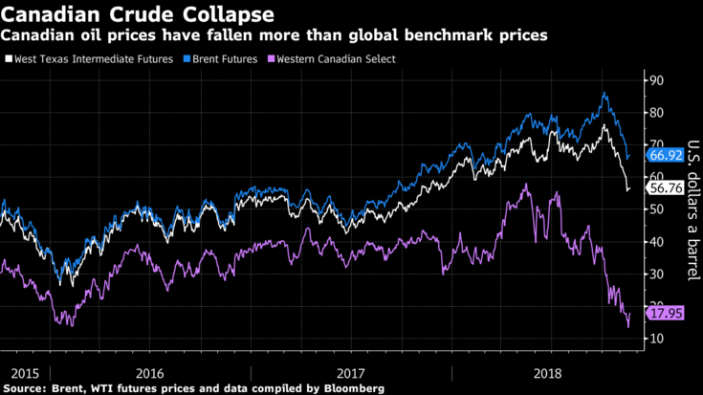
Looking Forward – Keystone XL and Oil
Canadian oil prices have hit record lows this year, trading at a $50 discount to WTI at points
Current situation is a cause of oversupply and a lack of transportation
Globally, oil demand is being outpaced by supply
Recent ruling by US courts will delay the Keystone XL pipeline for an additional 8 months
Notes:
The price of oil is largely affected by supply and demand equilibriums. In Canada we are currently experiencing massive oversupply, with producers unable to transport their oil to potential buyers, due to a lack of infrastructure. Constant delays and political hurdles have crippled pipeline construction, and currently canadian producers have become reliant on rail transportation and even tanker trucks to get their oil to market. The most recent keystone xl ruling will delay the much needed keystone xl by a further 8 months, increasing to the oversupply concerns. As well, the stoppage in the construction of the trans mountain pipeline is nota good sign for supply concerns moving forward. Currently Canadian oil is trading around a $40 USD discount to American WTI and this price differential will likely not improve until the supply imbalance is resolved, through production cuts or new infrastructure. Looking forward expect Canadian oil producers who are mainly exposed to wcs pricing to continue to see weak revenue and profits, with a recovery unlikely until 2020.

Slide 14
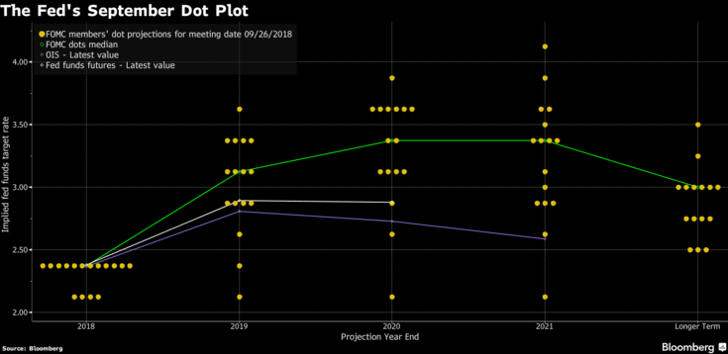
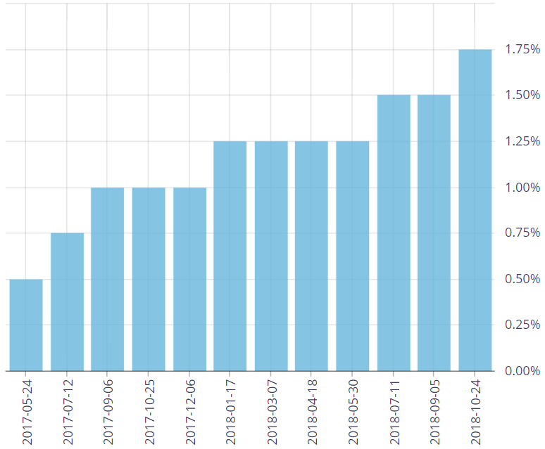
Looking Forward – Interest Rates
Who is Affected?
Rapid growth industries and emerging sectors (ie tech startups)
Financial Institutions
Junior Mining and Energy companies
Real Estate Industry, commercial and retail
Emerging markets with USD denominated debt
Healthcare
Telecom
Consumer Discretionary
Notes:
As the charts show, currently a rising interest rate environment in both Canada and the US
Most recent Bank of Canada decision was to raise the overnight rate from 1.5% to 1.75%, as well as signaling multiple rate hikes through 2019
US Fed rate is currently 2%, expected to reach 3% by the end of 2019
Overall, rising interest rates happen when markets are experiencing economic growth and are a sign of a strong economy. We have seen this in the last several years as rates have steadily rose after reaching near zero after the 2008 market crash. However the market seems to be cooling down, and rising interest rates may not have the same positive impact moving forward. Basically all industries are affected as debt becomes more expensive and you may see a slow down in growth, since a portion of it is funded by debt. Particularly bad for rapid growth industries and emerging industries, where there is little profit and growth is funded mainly by debt.
Financial Institutions are also affected, particularly retail and commercial banking as mortgage spending and consumer loans shrink, people become priced out of the market but they also benefit from increasing margins. Rates are still too low to be alarming, but it is crucial to pay attention as the balance between economic growth and inflation becomes shakier

Slide 15
Looking Forward – US-China Trade War
Asia-Pacific Economic Cooperation (APEC) Summit
Canada-U.S. border
Canada's manufacturing sector reliant on Chinese product
Price increases for American households

Slide 16





Looking Forward – Economic Indicators
Overview | Last | Reference | Previous | Range | Frequency
GDP Growth Rate | 0.70% | Jun 18 | 0.4 | -2.3 : 3.1 | Quarterly
Unemployment Rate | 5.80% | Oct 18 | 5.9 | 2.9 : 13.1 | Monthly
Inflation Rate | 2.20% | Sep 18 | 2.8 | -17.8 : 21.6 | Monthly
Interest Rate | 1.75% | Oct 18 | 1.5 | 0.25 : 16 | Daily
Consumer Price Index | 134 Index Points | Sep 18 | 134 | 12.1 : 134 | Monthly

